Slide 1

Chapter 7
Modelling Human Behavior
Notes:
This chapter explores the most common approaches by which researchers incorporate human behaviour into agent-based models. We explain why it can be necessary to model human behaviour and the main considerations that the researcher needs to be aware of when developing an agent-based model. From this, we present an overview of the two main broad approaches, mathematical and conceptual cognitive models when it comes to modelling human behaviour in agent-based models. We supplement this discussion with two case-studies that provide examples of how these approaches can be implemented, both examples have the model code available that can be downloaded and experimented with. The chapter finishes with a discussion of some of the thorny issues that researchers need to be aware of when attempting to simulate behaviour within agent-based models.

Slide 2
Learning Objectives
By the end of this chapter, students will be able to:
Argue why there is a need to model human behavior
Understand how researchers incorporate human behavior into agent-based models
i.e., mathematical and conceptual cognitive models
Be able to identify the challenges when attempting to simulate behavior within agent-based models.
Notes:
This chapter explores the most common approaches by which researchers incorporate human behaviour into agent-based models. We explain why it can be necessary to model human behaviour and the main considerations that the researcher needs to be aware of when developing an agent-based model. From this, we present an overview of the two main broad approaches, mathematical and conceptual cognitive models when it comes to modelling human behaviour in agent-based models. We supplement this discussion with two case-studies that provide examples of how these approaches can be implemented, both examples have the model code available that can be downloaded and experimented with. The chapter finishes with a discussion of some of the thorny issues that researchers need to be aware of when attempting to simulate behaviour within agent-based models.

Slide 3
Introduction
“Imagine how difficult physics would be if electrons could think.”
Murray Gell-Mann
(1969 Nobel Prize in Physics )

Slide 4
Introduction
One of the enduring challenges for geographers is understanding the consequences of individual actions over both time and space.
Unlike in the physical sciences where particles are somewhat well behaved under a specific set of conditions, humans react differently to a particular situation or stimulus.
Simulating individuals (human or otherwise) presents a unique challenge for modelers.
Notes:
The explosion in individual data, along with increases in computing power, offers some explanation for the rise in popularity of agent-based modelling over the two past decades. However, simulating individuals (human or otherwise) presents a unique challenge for modellers.

Slide 5
The Challenge of Simulating Human Behavior
Human behavior flows from three main sources: desire, emotion, and knowledge. (Plato)
Humans possess such diverse personality traits, varying levels of knowledge, experience, desires and emotions.
Many basic emotions are short-lived, but can lead to complex, often unpredictable, longer-term behavior.
Added to this humans do not live in isolation –
we are embedded within dense and interconnected networks encompassing work, social and family ties.
The challenge for the researcher is to represent not only the social relationships between agents, but also how they vary with space and time and how they influence the behaviors of the agents.

Slide 6
Pick a number
Kennedy (2012) challenges the people to answer the following question: Pick a number between 1 and 4.
The most common response is ‘three’ ....
The second most common answer is ‘two’.
Very few people decide to respond with either ‘one’ or ‘four’.
Sadly, there is not a serious study of this behavior but undocumented sources suggest that the response statistics are close to 50% for ‘three’, 30% for ‘two’ and about 10% for the other two answers.
Notes:
Fortunately, human behavior is often predictable, as the following example shows:

Slide 7
The Challenge of Simulating Human Behavior
What does Kennedy’s (2012) simple experiment tell us? Simply that human behavior is not purely random, that there is a degree of predictability to how an individual may behave in a given situation.
Therefore, if we gather enough accurate information about how an individual will react and behave (e.g., from case studies, newspaper reports, laboratory experiments), we can formulate rules that an agent can use

Slide 8
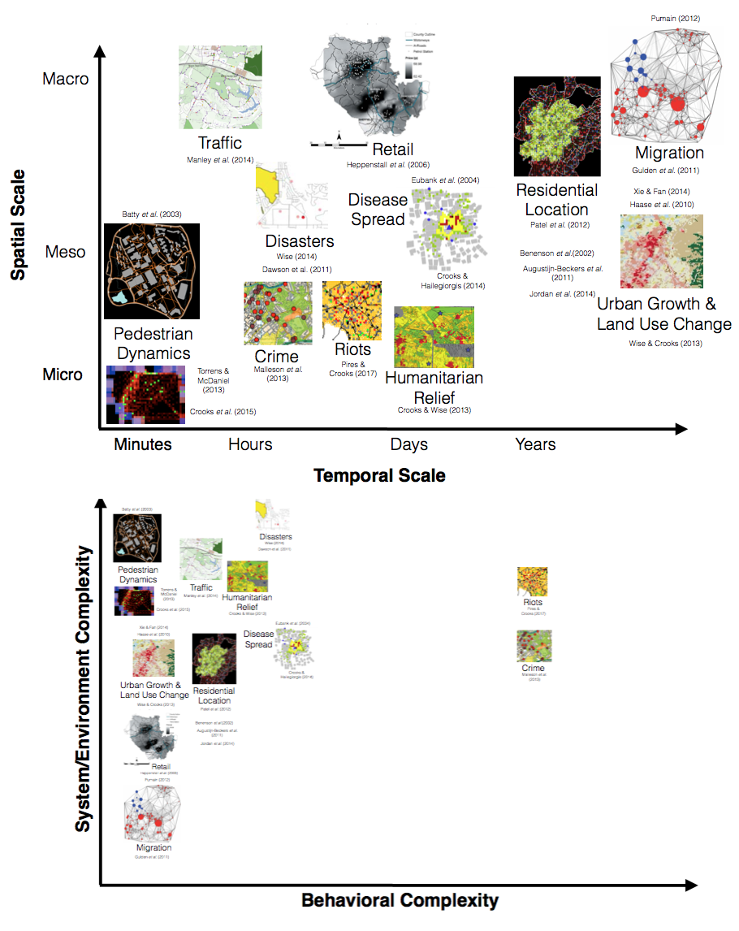
Behavioral Complexity Plotted Against Environmental Complexity for Selected Applications
Agent-based models based on the temporal or spatial scales for selected applications
Behavioral complexity plotted against environmental complexity for selected applications

Slide 9
The Challenge of Simulating Human Behavior
System/environment complexity: we are referring to how the models represent space
from abstract spatial representations – from the Schelling (1971) segregation model to models that capture the basic properties of space such as distance between places (e.g. Gulden et al., 2011; Pumain, 2012) and geographically explicit models that capture the complex geometries of the built environment.
Behavioral complexity: trying to categorize models from simple behaviors to more complex behavioral representations.
Simple models would be along the lines of the Schelling model or the pedestrian models of Crooks et al. (2015a), while at the other extreme the models would need to capture all the functions of a ‘real ’ person.
Few published agent-based models are both behaviorally and environmentally complex.

Slide 10
Behavioural Frameworks
Broadly speaking, there are two scientific approaches to modelling human behavior being developed:
Artificial intelligence using mathematical approaches;
conceptual cognitive approaches that attempt to model all forms of human cognition, including emotions, intuitions and motivations.
A number of architectures have been proposed to address how these traits should be mimicked

Slide 11
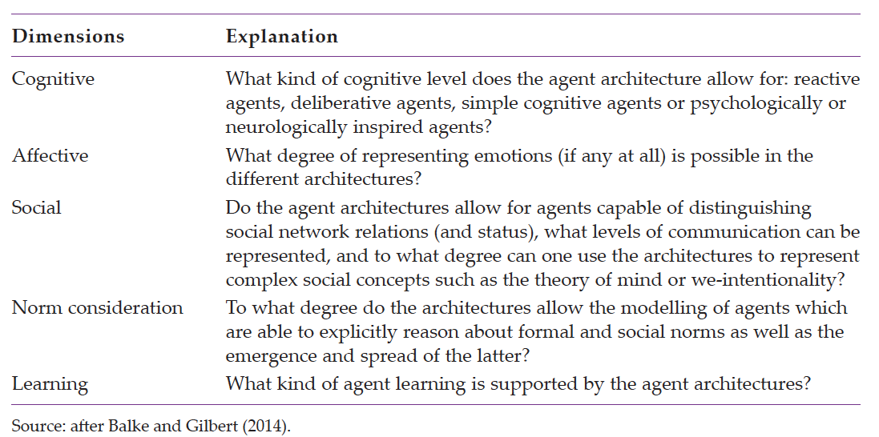
The five main dimensions for distinguishing agent architectures

Slide 12
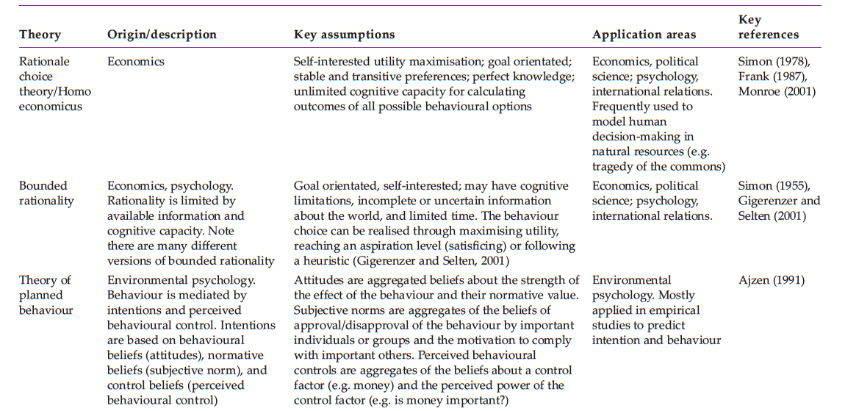
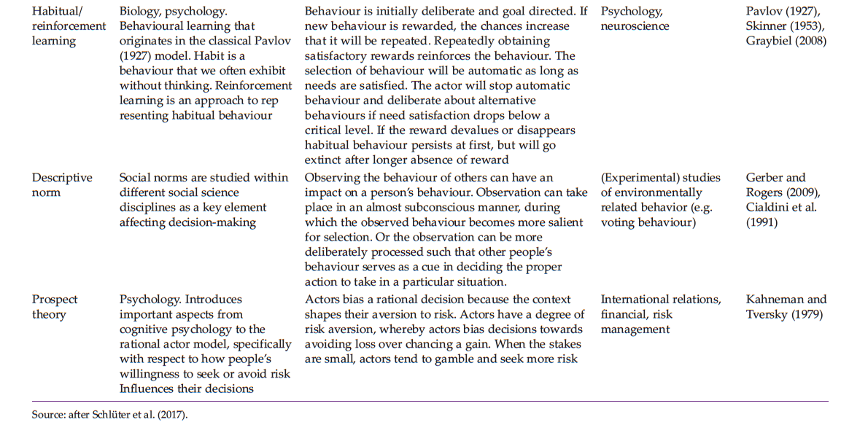
Overview of the key assumptions and application areas of popular theories used in representing behavior

Slide 13
Challenges
There are a number of important challenges that researchers need to address if they are to successfully embed theories on human decision-making into their models:
Finding the relevant theory, formalizing the theory and introducing causality
Making assumptions to fill logical gaps that appear when trying to formalize the theory
Simulating human interactions both in time and space requires the specification of causal relationships about how different factors such as social and psychological factors influence an agent’s decision-making.

Slide 14
Representing Behavior: Mathematical Approaches
Mathematical approaches center on the custom coding of behaviors within the simulation, such as using random number generators to select a predefined possible choice (e.g., to buy or sell).
Here we present two of the main approaches taken within agent-based models: probabilistic and threshold rules.
However, while it has been argued that these approaches to modelling are appropriate when behavior can be well specified, they might not be appropriate when more complex behaviors are needed.

Slide 15
Probabilistic Models
Probabilistic models are used when there is a degree of uncertainty or randomness that needs to be accounted for in the rules that an agent operates.
E.g., consider a hypothetical shopper buying their lunch.
There might have a choice of sandwiches or noodles, with a probability assigned to each (e.g., a 30% chance of choosing sandwiches and a 70% chance of choosing noodles).
Each time the simulation runs, they might choose different food.
These probabilities reflect a lack on information about the choice for lunch – we do not know why a person chooses one thing over another, so we take an educated guess at which it might be.

Slide 16
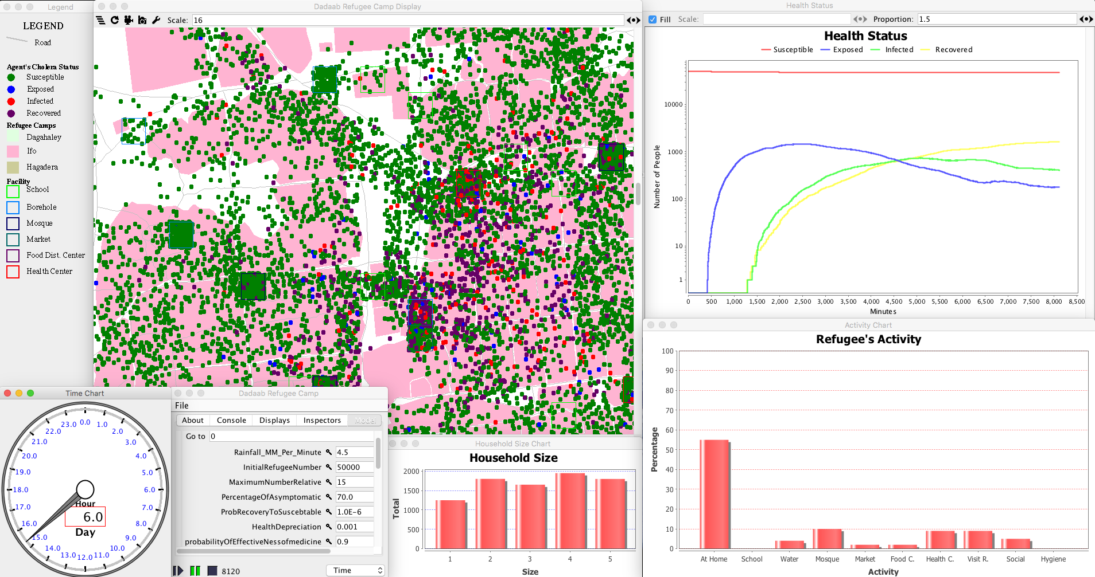
Probabilistic Model Example
Probabilistic rules can also be used when an event might take place, but not necessarily by choice of the agent. For example, consider a probability of becoming infected with a specific disease.
Appendix A1 - Disease Dynamics in a Refugee Camp

Slide 17
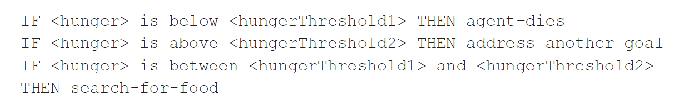
Threshold Models
Threshold rules come into operation when a preset value is exceeded. Depending on the value, this will result in behaviors from a predefined set:

Slide 18
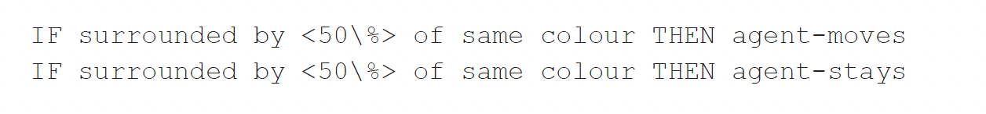
Threshold Model Example
Schelling (1971) segregation model as only two types of agent, yellow and green.
These agents possess a desire to live in a neighborhood (defined by its eight surrounding cells) with a percentage (the threshold) of neighbors who are identical to themselves.
Initially the agents are randomly distributed throughout the environment. As the simulation begins, the following rules come into play, demonstrated here using a threshold level of 50%:

Slide 19
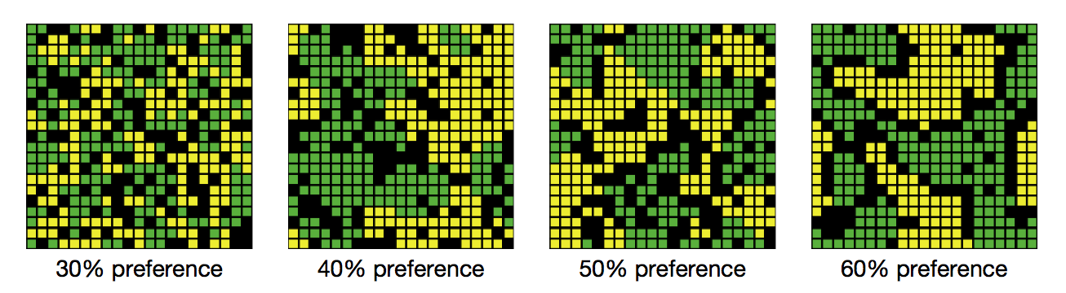
Resulting patterns of segregation from different threshold levels

Slide 20
Case Study: Simulating Consumer Behavior Using Probabilistic Rules
Simple probabilistic model to simulate different patterns of consumer behavior within a city.
This model addressed several key challenges, including:
How do we translate observed behavior into rules that an agent can operate satisfactorily,
Which of the many processes involved in this system should be included?
These questions were answered through a detailed analysis of a retailer’s loyalty card database covering a period of several months.

Slide 21
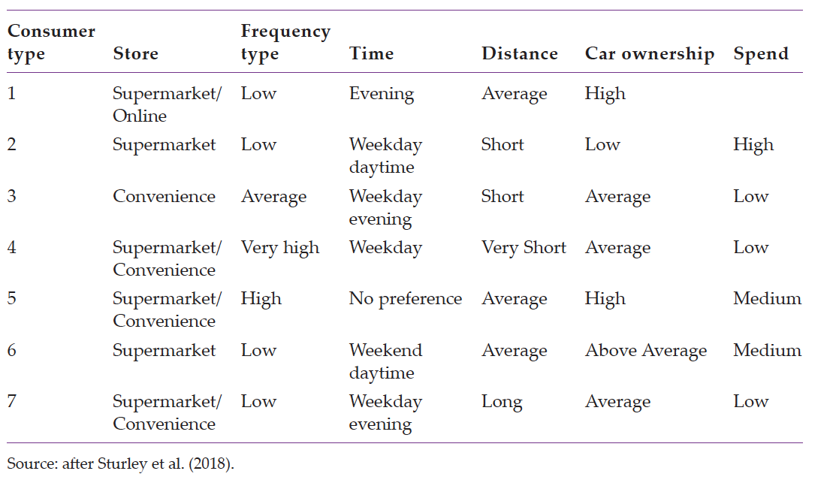
Summary of customer group characteristics

Slide 22
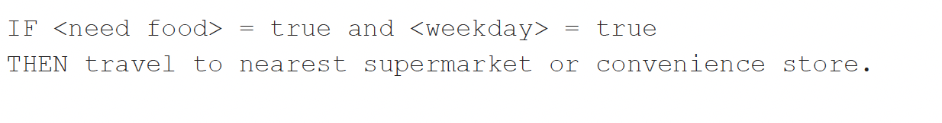
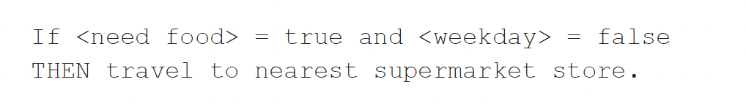
Case Study: Simulating Consumer Behavior Using Probabilistic Rules
A agent of consumer type 4 would operate the following rules:
And an agent of consumer type 6 would use the following:

Slide 23
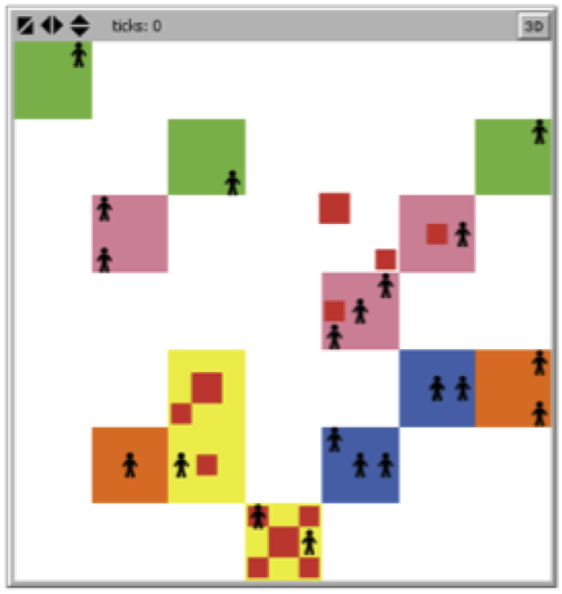
Basic spatial environment created within NetLogo that the consumer agents occupy
Model Available at: https://github.com/abmgis/abmgis/tree/master/Chapter07-ModellingHumanBehaviour/Models/Store_choice_model

Slide 24
Summary of Mathematical Approaches
While such rule sets are able to broadly simulate behavior, one of the main criticisms levelled at this approach is that it cannot easily account for the multiple components of human behavior, and they should only be used when behavior can be well specified.
For the representation of more sophisticated behaviours, cognitive frameworks are often more appropriate, and it is to these that we turn to next.

Slide 25
Conceptual Cognitive Models
The second broad class of models are conceptual cognitive models.
Here we will only present three examples of cognitive models
Beliefs–desires–intentions (BDI) model
Fast and frugal model
Physical conditions, emotional states, cognitive capabilities and social status (PECS) model

Slide 26
Beliefs–Desires–Intentions Model
The beliefs–desires–intentions architecture (Bratman et al., 1988) is perhaps the most popular architecture and is centered around equipping agents with the cognitive components of beliefs, desires and intentions.
This approach follows rational choice ideas because no action is performed without some form of deliberation.
Behavior of a BDI agent is characterized by achieving goal(s) which are decided upon and then a plan is formed in order to satisfy the goals.
Beliefs represent the agent’s internal knowledge of the world
Desires are all the goals which the agent is trying to achieve.
Intentions are sometimes viewed as a subset of goals, while at other times they are viewed as the set of plans which will achieve the desired goals.

Slide 27
Beliefs–Desires–Intentions Model
The BDI architecture has been widely used in a diverse set of applications
Air traffic management (e.g., Rao & Georgeff, 1991)
Characters in virtual environments (e.g., Torres et al., 2003)
Operations within a shipping container terminal (e.g., Lokuge and Alahakoon, 2004)
Transportation (e.g., Horni et al., 2016)
Geopolitics (e.g., Taylor et al., 2004)
Crime (e.g., Brantingham et al., 2005a)

Slide 28
Fast and Frugal Model
The fast and frugal approach consists of a school of heuristic rule sets, designed to better capture how decision-making is made under uncertainty.
Rather than identifying and measuring all alternatives within an environment, decision-makers will instead use simple cues on which to base their decisions.
From a modelling perspective, the fast and frugal approach resembles a decision tree structure, and unlike other approaches, the model considers the cues affecting a decision sequentially in the order of their importance rather than in parallel.

Slide 29
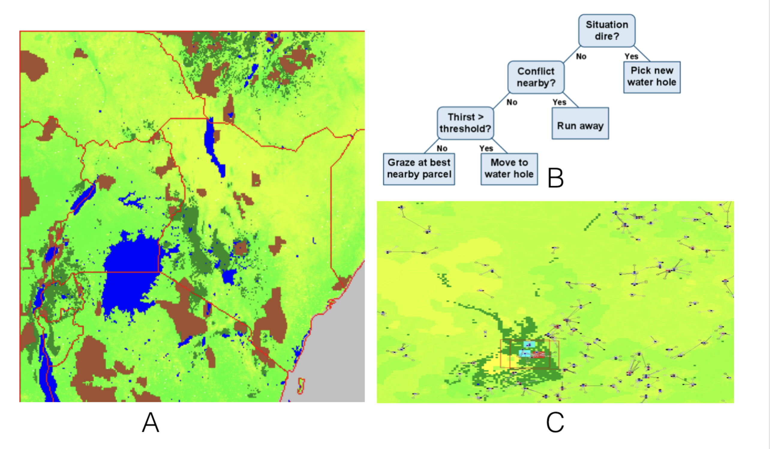
Example of the Fast and Frugal Model
Appendix A14 - RiftLand: Analyzing Conflict, Disasters, and Humanitarian Crises in East Africa

Slide 30
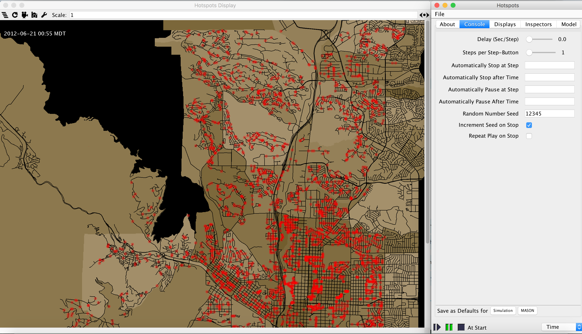
Example of the Fast and Frugal Model
Appendix A9 - Using Social Media Content To Inform Agent-based Models For Humanitarian Crisis Response

Slide 31
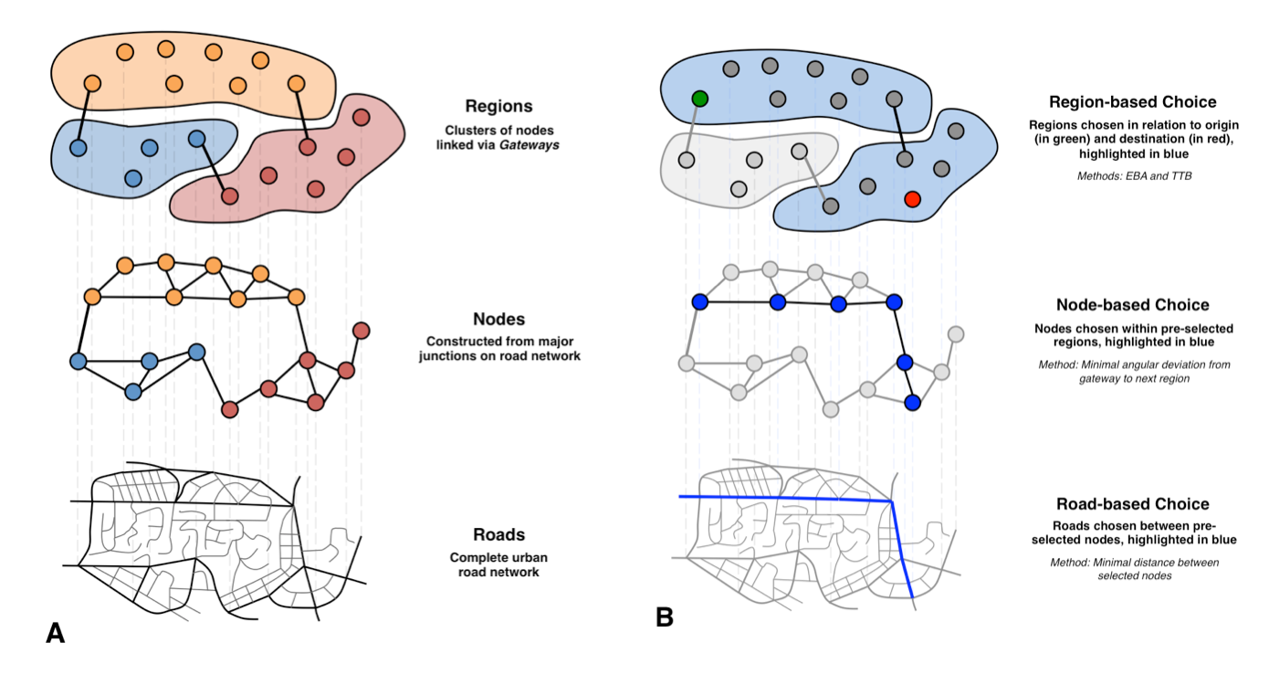
Heuristic model of route choice
(A) breakdown of space into a hierarchy, differentiating regional, node-based, and road segment-based decision-making; (B) an example route choice process, where different heuristic rule sets are engaged at each level of the hierarchy
Notes:
Heuristic model of route choice: (A) breakdown of space into a hierarchy, differentiating regional, node-based, and road segment-based decision-making; (B) an
example route choice process, where different heuristic rule sets are engaged at each level of the hierarchy

Slide 32
Fast and Frugal vs. Probabilistic Models
How is this framework different from the probabilistic models?
One of the key differences between the fast and frugal method and the probabilistic models is that the decisions are based on heuristic facts, and the order in which the decisions are made relates to ordered facts
i.e., what are considered the most important to least).
Agents decide serially if they have enough information on which to act, and if not, they consider the next factor.
In probabilistic models an agent’s actions are drawn from a probability
e.g., the probability of infection or the probability of attaching to a new node).

Slide 33
Physical Conditions, Emotional State, Cognitive Capability and Social Status (PECS)
The PECS framework states that human behavior can be modelled by taking into account physical conditions, emotional states, cognitive capabilities and social status of an agent.
The framework is modular, allowing separate components to control each aspect of the agent’s behavior.
Consider a person in a shop who is contemplating purchasing some goods. They might experience
Physical needs (such as hunger),
Emotional states (such as surprise at the available goods),
Cognition (such as information about current prices) and
Social status (which will, for example, affect how the agent reacts to the shop assistant).
Schmidt (2000) and Urban (2000) argue that every aspect of human behavior can be modelled using these components, although, depending on the application, it might not be necessary to incorporate all of them.

Slide 34
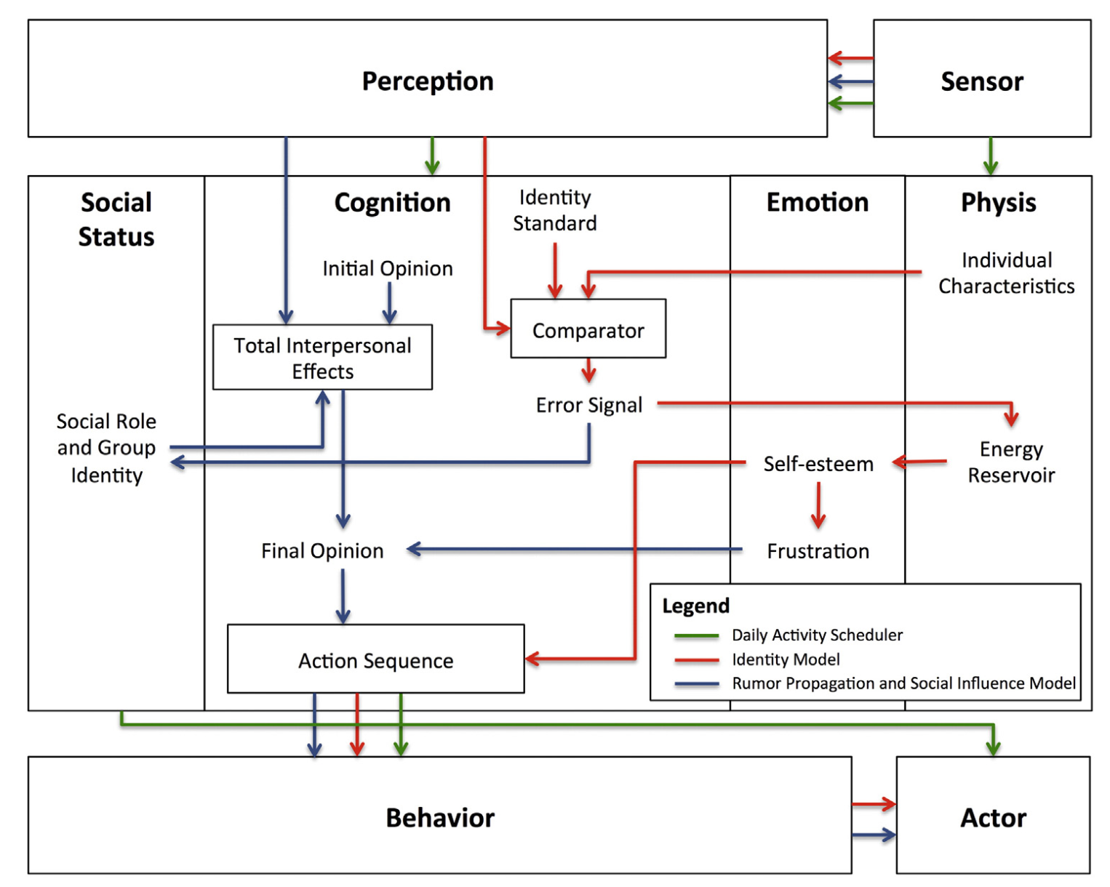
A high-level representation of the resident agent behavior incorporated into the PECS framework
After Pires and Crooks, 2017, which was adapted in turn from Schmidt, 2000)

Slide 35
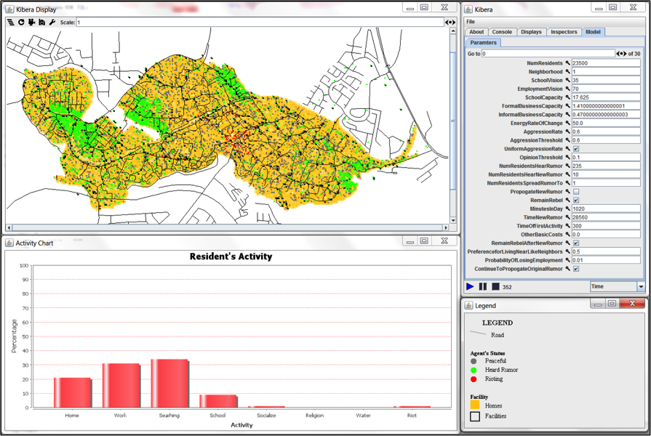
GUI of the Simulating Behavior in Riots using a Cognitive Model
For the model see: https://github.com/abmgis/abmgis/tree/master/AppendixA/Riots while https://youtu.be/gsaQK6lPxf0 shows an example model run

Slide 36
Summary
There are different ways one can incorporate human behavior within agent-based models.
The 2 main groups of behavioral models that are used to implement behavior:
Mathematical and Conceptual cognitive.
The most common implementations of
Whilst behavioral frameworks provide a useful starting point for implementing behavior, caution must also be exercised.
Challenges exist when it comes to simulating human behavior.
New forms of micro-level data (big data) offers a potential solution to these challenges and offers a rich vein for understanding behavior more realistically than has previously been possible.

Slide 37
Further Reading
Readers wishing to know more about the issues concerned with modelling human behavior are referred to:
Kennedy, W. (2012), Modelling human behavior in agent-based models. In A.J. Heppenstall, A.T. Crooks, L.M. See, and M. Batty (eds), Agent-Based Models of Geographical Systems, pp. 167–180..
For a discussion of the different types of behavioral frameworks, see:
Balke, T. and Gilbert, N. (2014), How do agents make decisions? A survey. Journal of Artificial Societies and Social Simulation, 17(4), 13. Available at http://jasss.soc.surrey.ac.uk/17/4/13.html.
Schlüter et al., (2017), A framework for mapping and comparing behavioural theories in models of social-ecological systems. Ecological Economics, 131, 21–35.

Slide 38
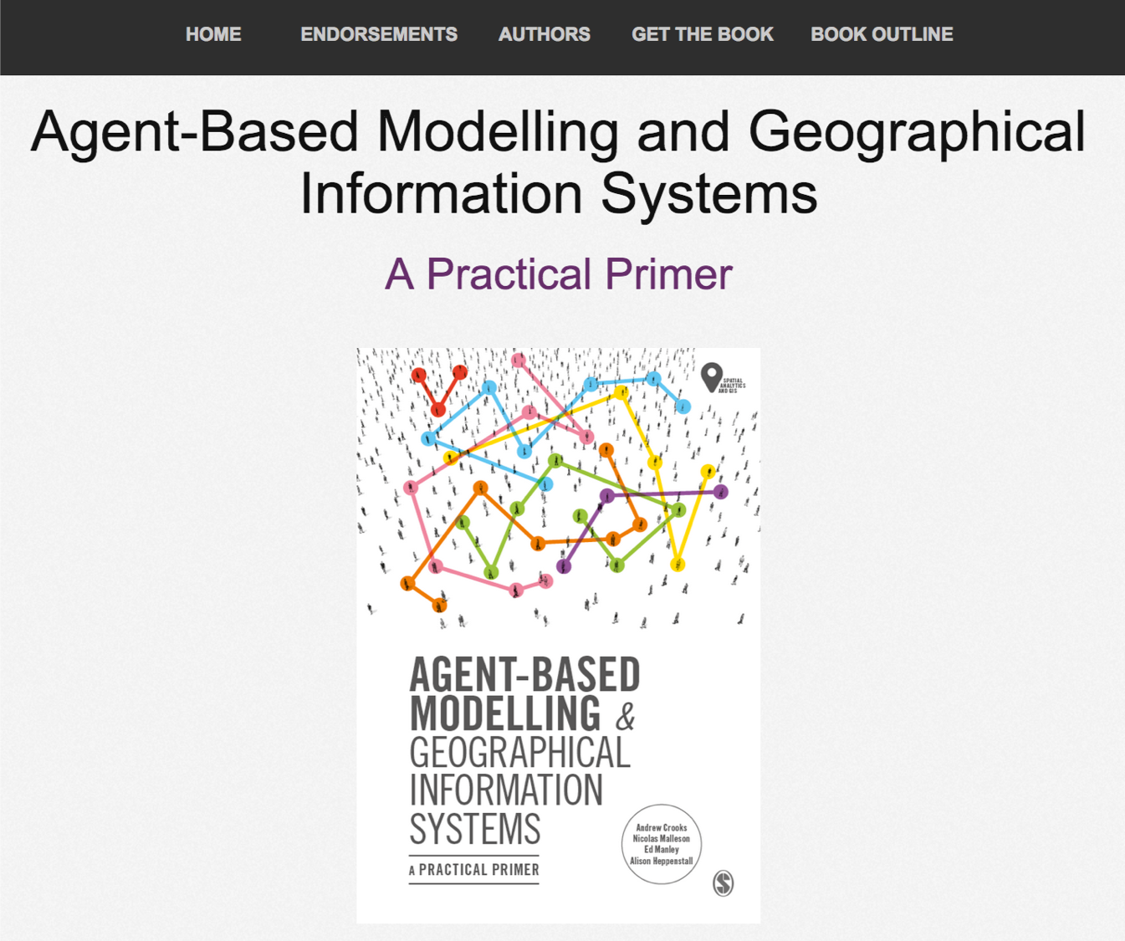
Online Resources
Visit: https://github.com/abmgis/abmgis/tree/master/Chapter07-ModellingHumanBehaviour for a selection of models to highlight core concepts introduced in this chapter along with a tutorial.

